Slide 1
Parking Space Classification
Joshua Ellis | Anthony Harris | Naseem Saquer
Notes:
Josh

Slide 2
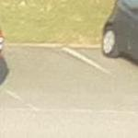

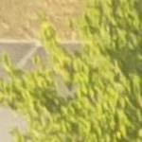
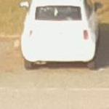
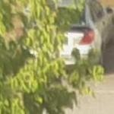
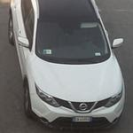
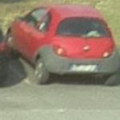
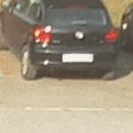
The Problem
Classify a parking space as “free” or “busy”
Dataset URL: http://cnrpark.it/
12.5k image subset
145k image extended set
Notes:
Anthony

Slide 3
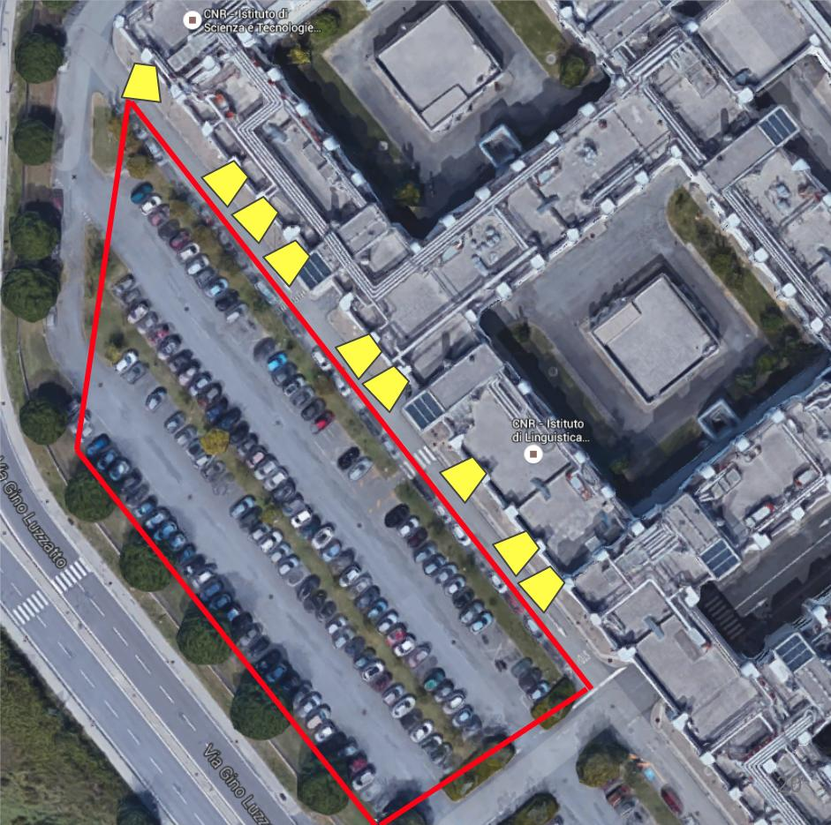
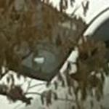


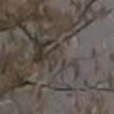
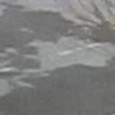
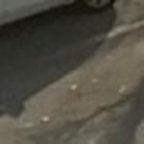
The Data: CNR-EXT-150x150
Weather | Busy | Free | Sum
Overcast | 23176 | 21067 | 44243
Rainy | 18618 | 18926 | 37544
Sunny | 37513 | 25665 | 63178
TOTAL: | 79307 | 65658 | 144965
9 Cams
Nov. 2015 – Feb. 2016
23 Days
Notes:
Anthony

Slide 4
Our Goal
This problem is not novel
Has been solved with AlexNet
Between 86%-98% Accuracy
We want to compare different strategies
AlexNet
ResNet
DenseNet
Notes:
Anthony

Slide 5
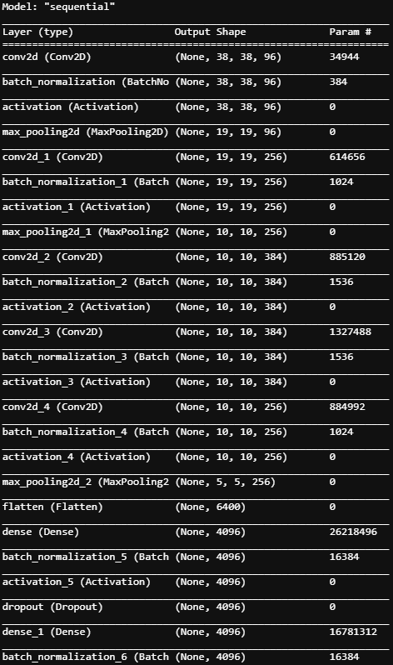
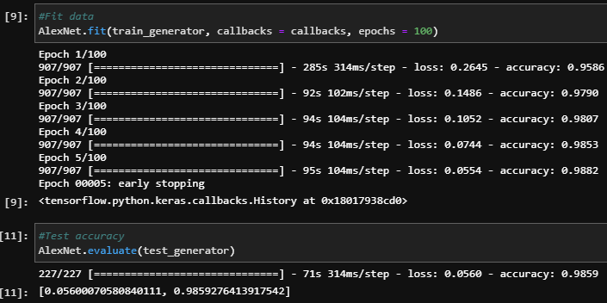
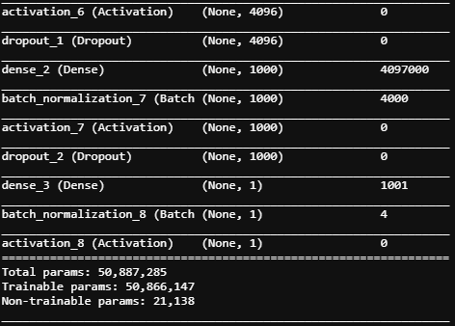
AlexNet
Very deep network with ~50 million parameters
Utilizes ReLU activation, Batch Normalization, and Dropout.
Notes:
Naseem

Slide 6
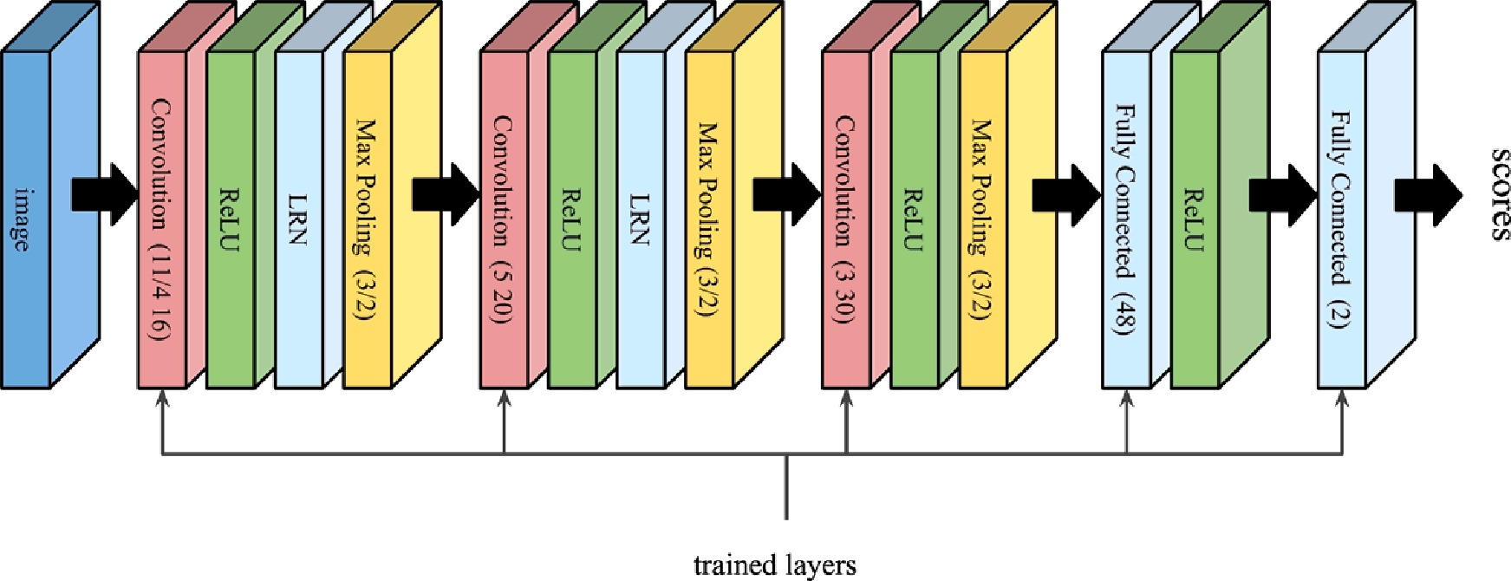
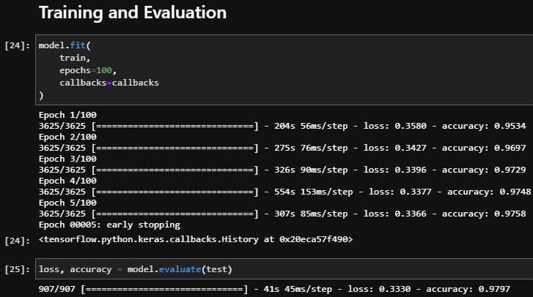
Mini AlexNet
Network inspired by Alexnet with ~20,000 parameters
Architecture proposed by Deep learning for decentralized parking lot occupancy detection (2017), by Amato et al.
Original paper reports an accuracy of 90.71% on the testing set
Notes:
Naseem

Slide 7
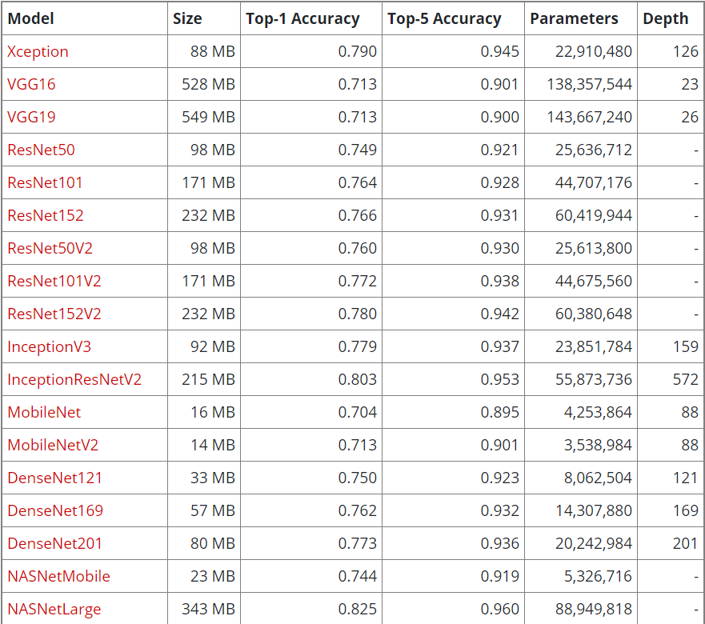
Keras Predefined Models
NASNetLarge
InceptionResNetV2
DenseNet201
DenseNet121
Source: https://keras.io/api/applications/
Notes:
Josh

Slide 8
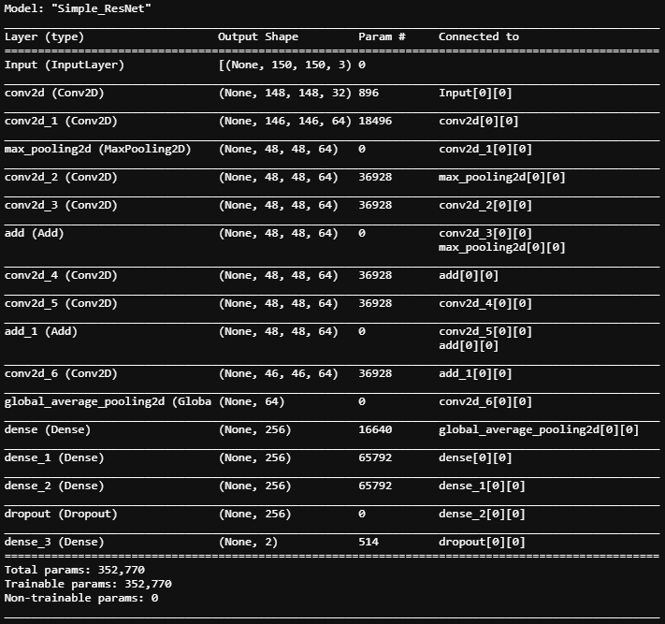
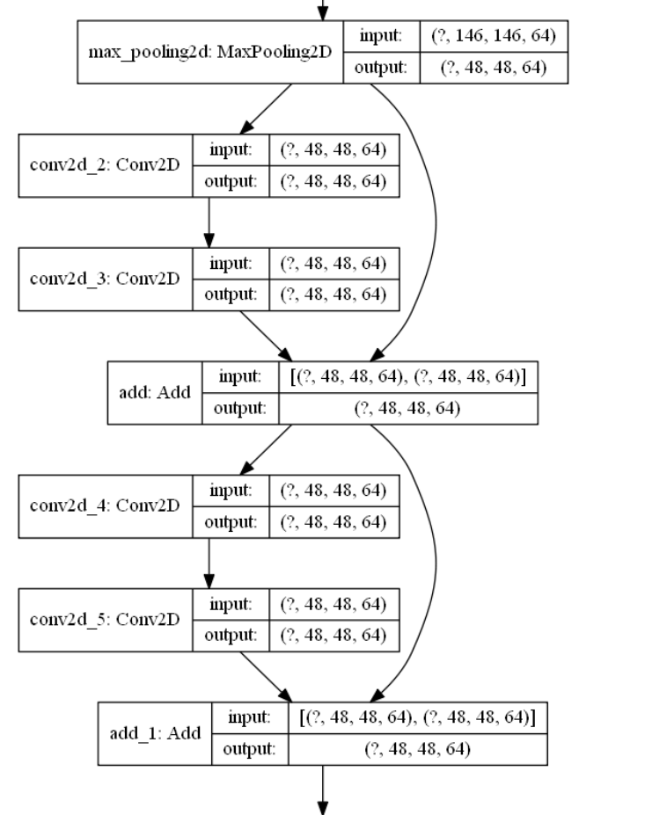
ResNet
Residual Connections
Helps counter exploding / vanishing gradient
 | CNRPark | CNR-EXT
Train Epochs | 10 | 10
Train Acc | 93.04% | 97.53%
Test Acc | 92.82 | 98.15%
Model based on: TF Toy ResNet Model
Notes:
Anthony

Slide 9
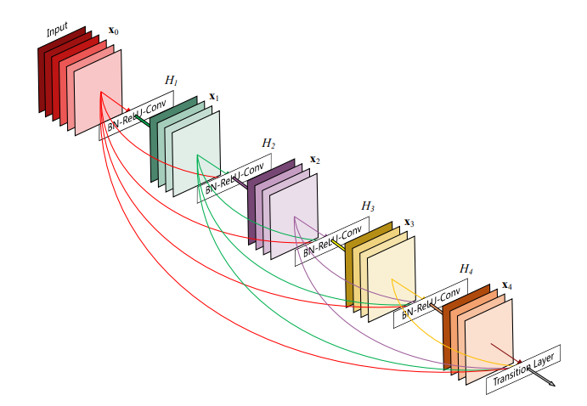
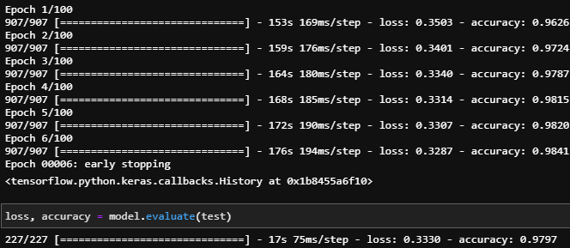
DenseNet
Furthers the ResNet concept
Contains multiple densely connected convolutional blocks
Each layer takes all preceding feature maps as input
~350,000 training parameters
Source: Densely Connected Convolutional Networks (2016)
Huang, Gao et al.
Notes:
Naseem

Slide 10
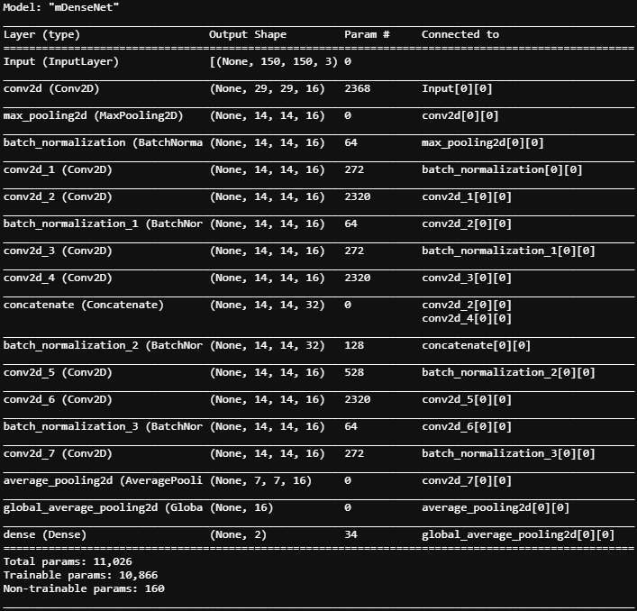
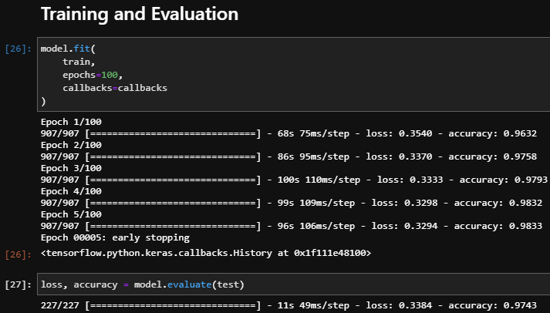
Mini DenseNet
Network inspired by Densenet with ~10,000 parameters
Achieves very close accuracy to original network with ~3% of the parameters
Made by reducing number of filters and Dense blocks
Notes:
Naseem

Slide 11
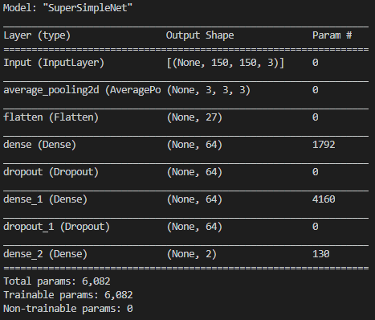
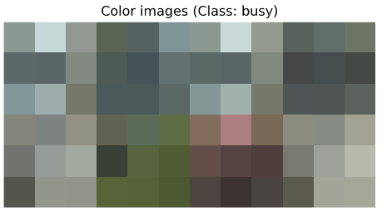
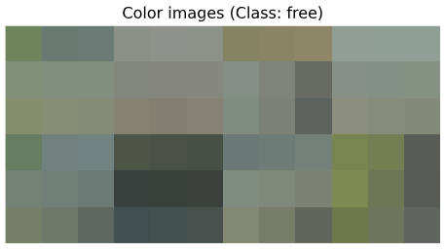
SimpleNet
Notes:
Josh

Slide 12
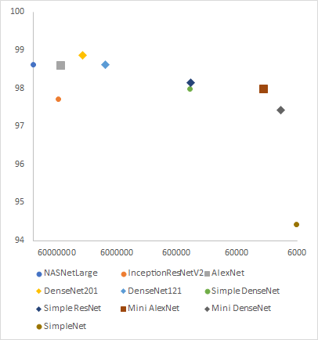
Conclusion
Model | Params | Train Acc | Test Acc
NASNetLarge | 147,381,332 | 98.33% | 98.62%
InceptionResNetV2 | 56,123,106 | 97.85% | 97.71%
AlexNet | 50,887,285 | 98.82% | 98.59%
DenseNet201 | 22,271,042 | 98.18% | 98.87%
DenseNet121 | 9,151,554 | 98.39% | 98.61%
Simple DenseNet | 361,794 | 98.41% | 97.97%
Simple ResNet | 352,770 | 97.53% | 98.15%
Mini AlexNet | 21,628 | 97.58% | 97.97%
Mini DenseNet | 11,026 | 98.33% | 97.43%
SimpleNet | 6,082 | 92.25% | 94.43%
Notes:
Josh

Slide 13
Questions?

